Slide 1

Capstone project – sales analysis

Slide 2
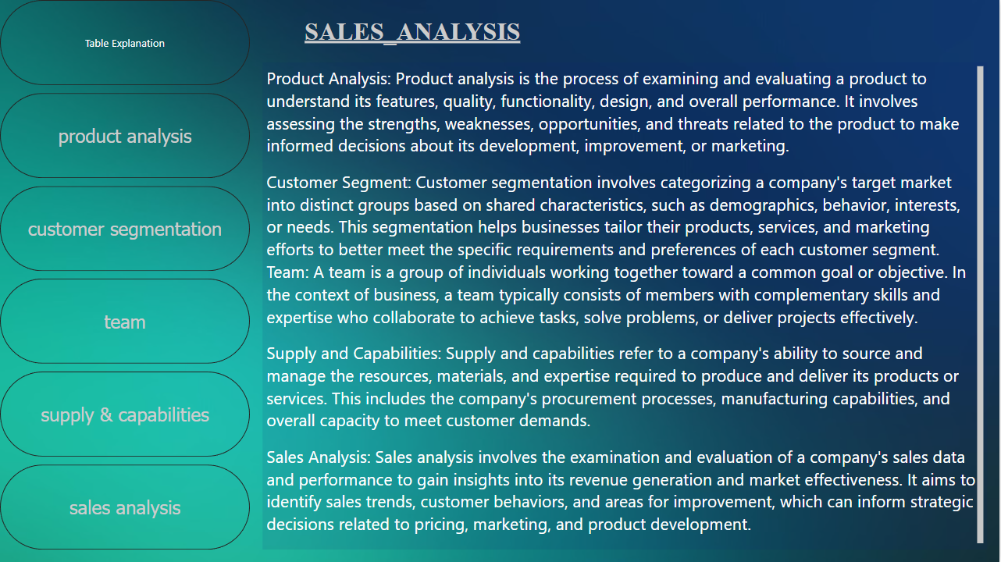

Slide 3


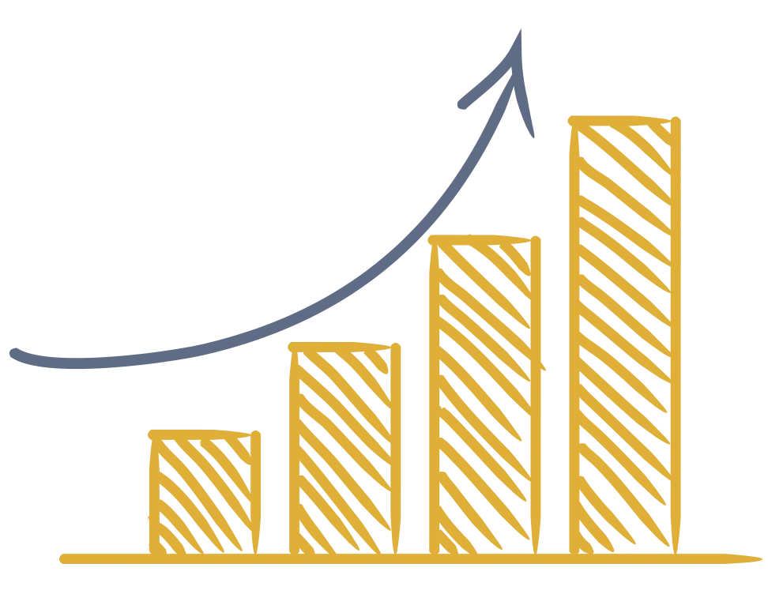
Sales objective analysis involves the assessment and evaluation of sales-related goals and targets to determine their effectiveness and alignment with the overall business strategy. In short:
The goal of sales objective analysis is to ensure that sales efforts are focused on achieving strategic goals and to continually refine and improve sales strategies for better performance. The goal of sales analysis is to evaluate sales data and processes to gain insights, improve strategies, and ensure alignment with business objectives, ultimately enhancing sales performance and profitability.
The scope of sales analysis includes evaluating and gaining insights from sales-related data and processes, covering areas like performance metrics, sales channels, product analysis, customer segmentation, competitor analysis, team performance, inventory management, forecasting, marketing ROI, and more. It helps organizations make data-driven decisions, optimize sales strategies, and improve overall business performance.

Slide 4



Sales analysis provides valuable insights into sales performance, customer behavior, and market trends, helping businesses make informed decisions to increase revenue and efficiency.
A sales analysis report summarizes sales performance and trends, while recommendations provide actionable insights to improve sales strategies and achieve better results.
A sales analysis dashboard is a visual display of key sales data, performance metrics, and trends, providing a concise, real-time overview of the sales department's performance and helping in making data-driven decisions.

Slide 5
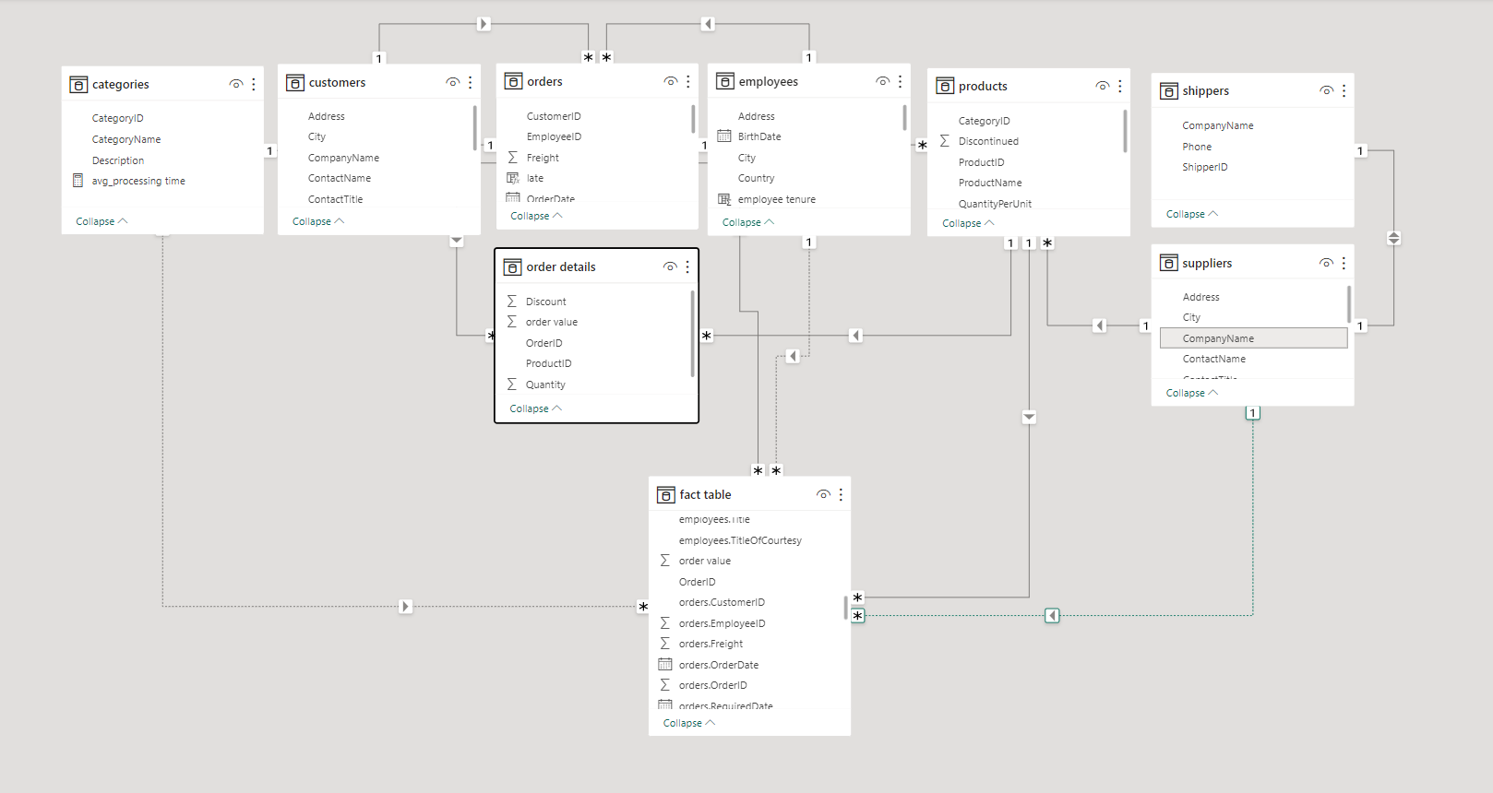

Slide 6


Power BI-
Problem Statement

Slide 7
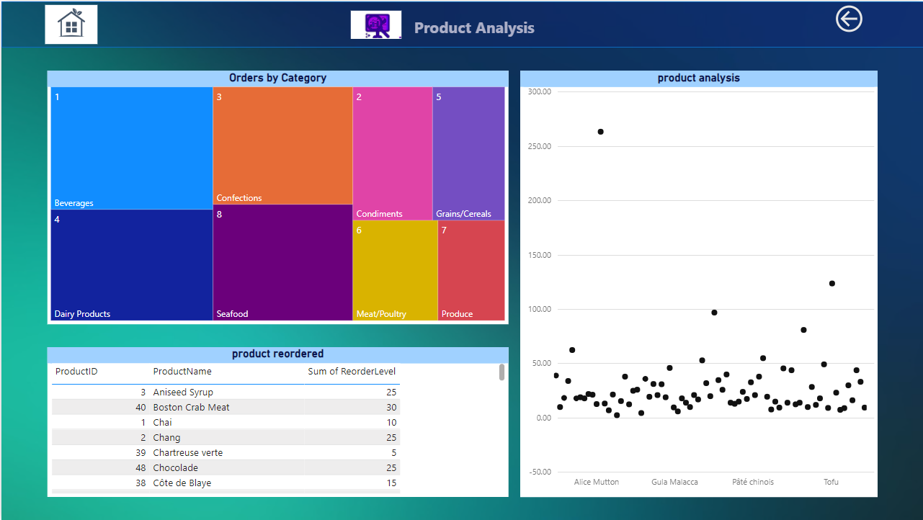

Slide 8
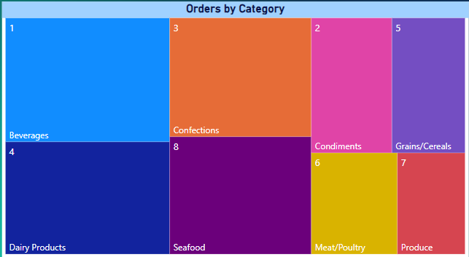
How does the sales volume vary across different product categories? Can we create a bar chart or tree map to display it?
Yes, you can create a tree map to display the distribution of sales volume across different product categories. A tree map is an excellent choice for visualizing the distribution of sales volume or the count of orders by categories, especially when you want to show how each category contributes to the overall total. Each category will be represented as a rectangle within the tree map, and the size of the rectangle will correspond to the sales volume or order count for that category. This provides a visual representation of how different categories compare in terms of their contribution to sales or order counts.
Here ,beverages have highest sales volume and produce have lowest sales volume

Slide 9
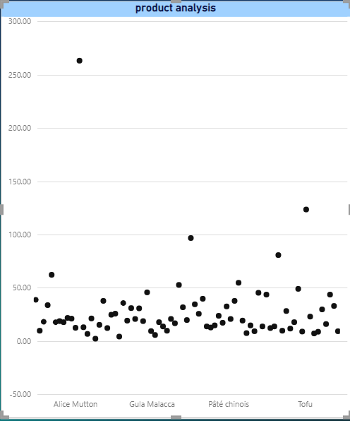
Can we visualize the pricing distribution of products using a box plot or violin plot?
Here is the price distribution of products ,
and we can see that Alice Mutton is at the highest

Slide 10
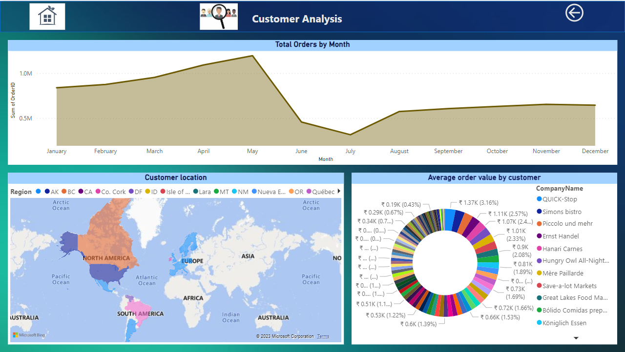

Slide 11
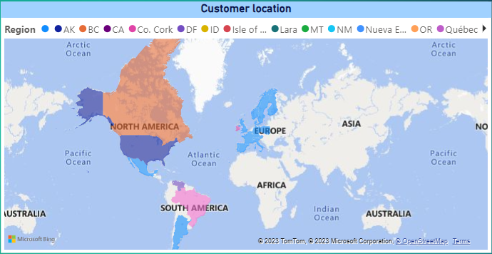
How does customer distribution vary across different regions or customer segments? Can we visualize it on a map or bar chart?
You can visualize customer distribution across different regions on a map and across customer segments using a bar chart. Use a map to show the geographical distribution by region and a bar chart to compare customer counts across segments or non-geographical categories.
Here, North America region has the maximum customers

Slide 12
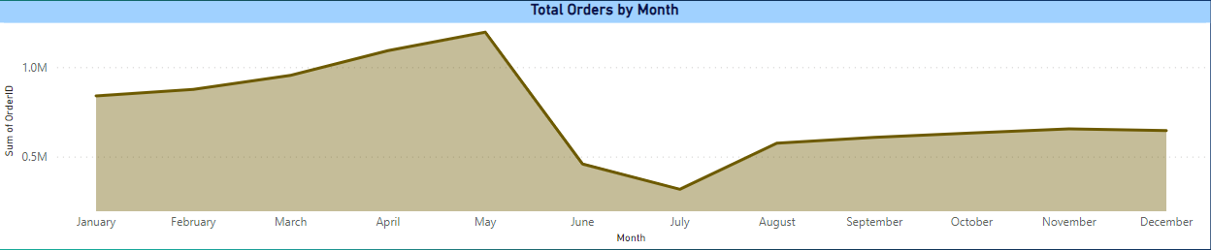
What is the trend in customer acquisition over time? Can we create a line chart or area chart to display it?
YES, We can distribute numbers of orders we get corresponding to
month
Here May month has maximum sales followed by April and July month has lowest sales

Slide 13
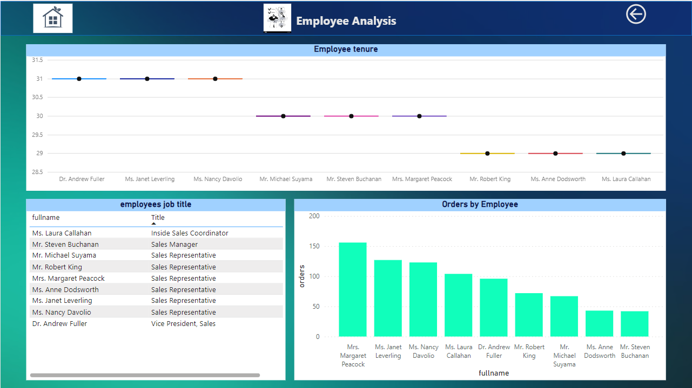

Slide 14
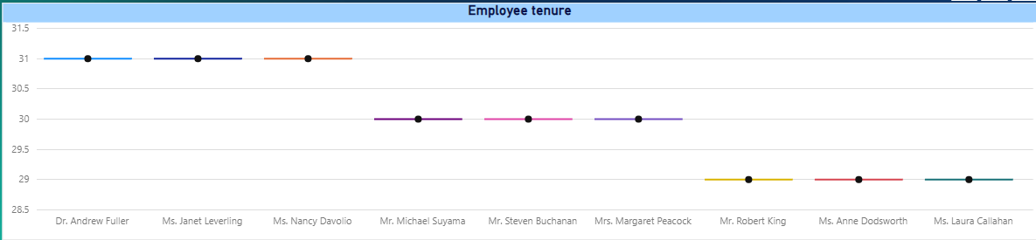
What is the distribution of employee tenure? Can we create a histogram or box plot to display it?
The distribution of employee tenure can be displayed using a histogram or a box plot, which provides insights into the spread and central tendency of employee tenure lengths.
Here the average tenure can be taken as 30 years
And maximum tenure is 31 years
And minimum tenure is 29 years

Slide 15
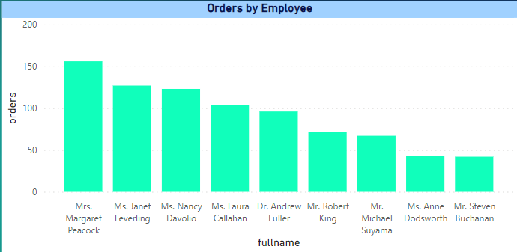
How does employee productivity vary across different departments or job roles? Can we create a stacked bar chart or grouped column chart to visualize it?
To visualize how employee productivity varies across different departments or job roles, you can create a stacked bar chart or grouped column chart, which allows for easy comparison of productivity levels within these categories
Here Mrs. Margaret Peacock has sold maximum product and she is from Sales Representative

Slide 16
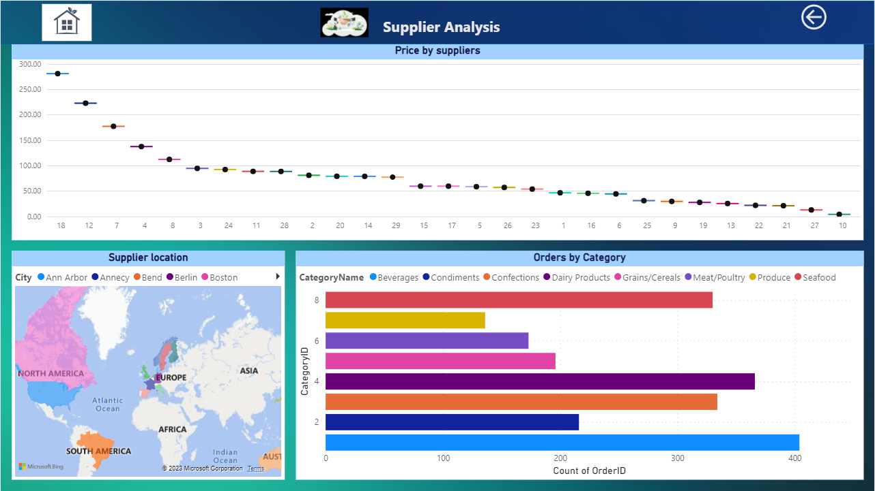

Slide 17
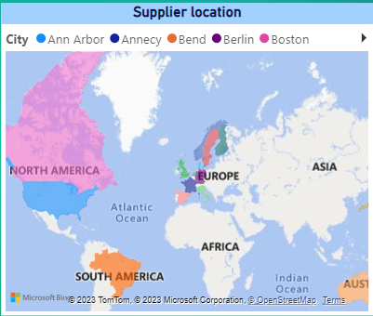
Can we visualize the geographical distribution of suppliers using a map or bubble chart?
Yes, you can visualize the geographical distribution of suppliers using a map or a bubble chart, both of which are effective for displaying supplier locations.
Here USA country region has the maximum suppliers

Slide 18
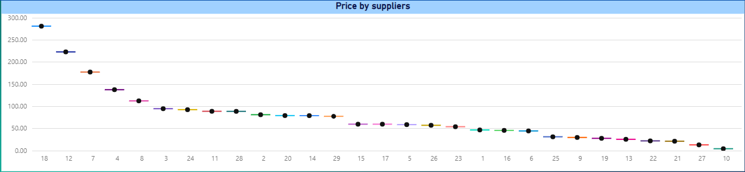
How does the cost or pricing structure vary across different suppliers? Can we create a box plot or stacked bar chart to display it?
To visualize the variation in cost or pricing structures across different suppliers, you can create a box plot or a stacked bar chart, allowing for comparisons of pricing information among suppliers.
Here Aux Joyeux ecclesiastiques (company name) 18. supplier has the maximum price

Slide 19
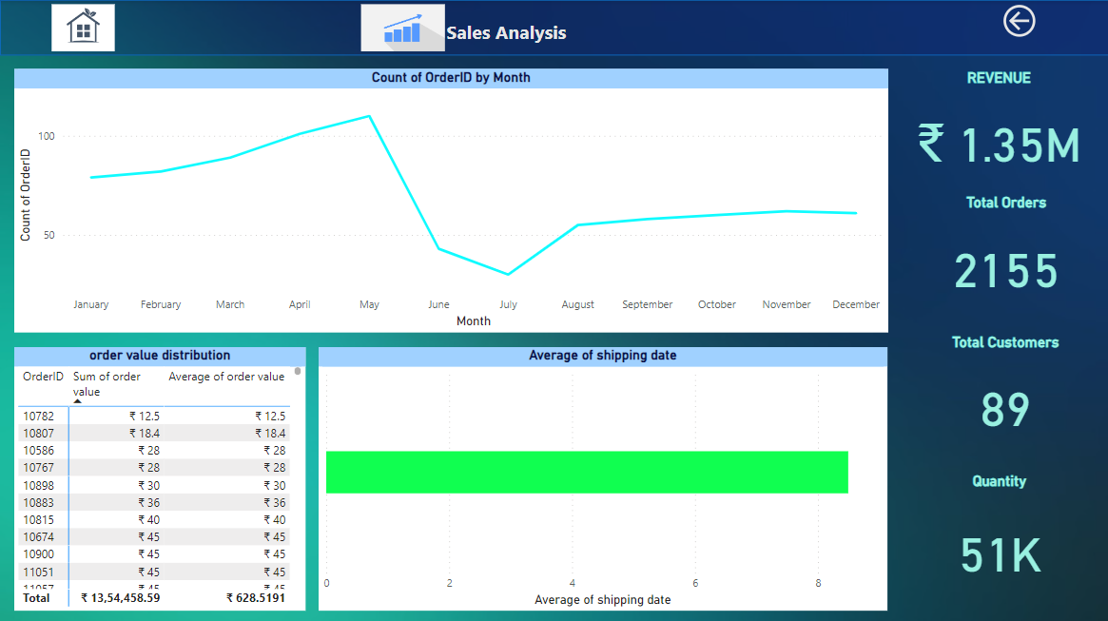

Slide 20
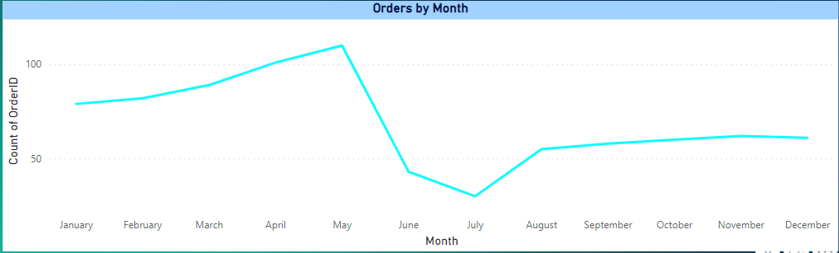
How does order volume change over time? Can we create a time series chart or stacked bar chart to visualize it?
To visualize changes in order volume over time, you can create a time series chart, which is ideal for showing trends in order volume. Stacked bar charts are typically used for different purposes, like showing composition within a single time period.
Here May month has maximum order volume and July has minimum order volume

Slide 21
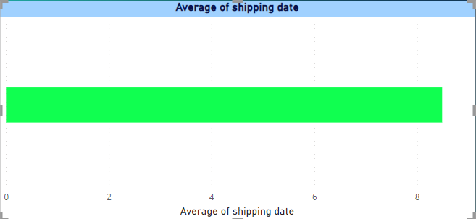
Can we visualize the average order processing time or shipping duration using a bar chart or box plot?
Average shipping date can be between 9 to 10

Slide 22
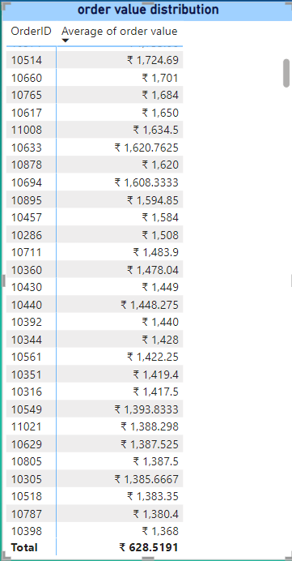
What is the distribution of order values? Can we create a histogram or box plot to display it?
Yes, we can create a box plot chart but it will be very difficult to understand.
I think table or matrix will be more suitable.
orderID 10865 10981has the maximum ordervalue which is 15,810 and the lowest orderID 10462 has the lowest sales order value 4.8
Here, we have taken the average order value.

Slide 23

EDA: PROBLEM STATEMENTS

Slide 24
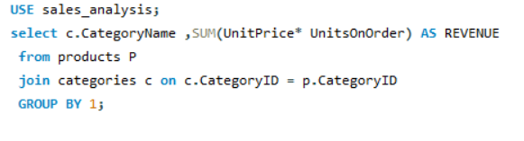
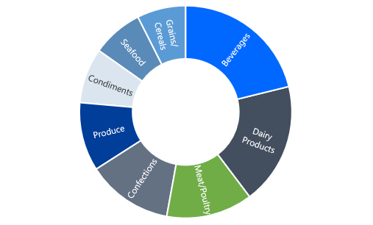
Are there any specific product categories or SKUs that contribute significantly to order revenue? Can we identify them through visualizations?
category | revenue
Beverages | ₹ 2,86,526.95
Condiments | ₹ 1,13,694.75
Confections | ₹ 1,77,099.10
Dairy Products | ₹ 2,51,330.50
Grains/Cereals | ₹ 1,00,726.80
Meat/Poultry | ₹ 1,78,188.80
Produce | ₹ 1,41,623.09
Seafood | ₹ 1,05,268.60
Here, beverages have highest sales revenue and produce have lowest sales revenue

Slide 25
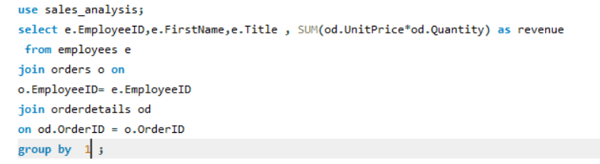
8. How does employee turnover vary across different departments or job roles? Can we visualize this using bar charts or heatmaps?
Sum of revenve | Column Labels
Row Labels | Inside Sales Coordinator | Sales Manager | Sales Representative | Vice President, Sales | Grand Total
Andrew |  |  |  | 177749.26 | 177749.26
Anne |  |  | 82964 |  | 82964
Janet |  |  | 213051.3 |  | 213051.3
Laura | 133301.03 |  |  |  | 133301.03
Margaret |  |  | 250187.45 |  | 250187.45
Michael |  |  | 78198.1 |  | 78198.1
Nancy |  |  | 202143.71 |  | 202143.71
Robert |  |  | 141295.99 |  | 141295.99
Steven |  | 75567.75 |  |  | 75567.75
Grand Total | 133301.03 | 75567.75 | 967840.55 | 177749.26 | 1354458.59
Here, there are 6 employees in sales representative and make 967840.55 revenue which more than half of total revenvue

Slide 26
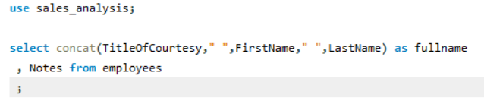
9. Can we identify any patterns or clusters in employee skill sets or qualifications through visualizations? How can this information be used for talent management?
Name | skills | qualification
Dr. Andrew Fuller | "The Art of the Cold Call." | BA in psychology
Mr. Michael Suyama | fluent in French and Italian and reads German | Ph.D. in int. marketing
Mr. Robert King | food retailing management | bs degree in chemistry
Mr. Steven Buchanan | Culinary Arts | MA in Culinary Arts
Mrs. Margaret Peacock | fluent in French. | BA in english
Ms. Anne Dodsworth | fluent in Japanese and can read and write French, Portuguese, and Spanish. | MBA,Marketing
Ms. Janet Leverling | Selling | BSC degree
Ms. Laura Callahan | reads and writes French. | BA in psychology
Ms. Nancy Davolio | fluent in French and German. | BA in english
qualification | Count of Name
BA in english | 2
BA in psychology | 2
bs degree in chemistry | 1
BSC degree | 1
MA in Culinary Arts | 1
MBA,Marketing | 1
Ph.D. in int. marketing | 1
Here, we can conclude that there are 2 employee in BA in psychology and BA in English
And one in each mentioned other fields

Slide 27
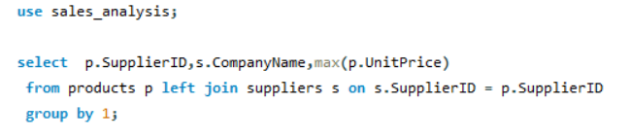
15. Can we identify any trends or patterns in supplier costs or pricing structures through visualizations? How can this information be used for procurement optimization?
Here, Aux Joyeux ecclesiastiques (company name) supplier has the maximum price and Refrescos americans LTDA has lowest price

Slide 28
Sales analysis for import-export companies can reveal several valuable insights and strategies to optimize their operations and increase profitability. Some strategies that can be identified through sales analysis for such companies include:
Market Segmentation: Identifying the most profitable markets or customer segments to focus resources and marketing efforts on.
Product Performance: Analyzing which products generate the most revenue and profit, helping in inventory management and product selection.
Pricing Optimization: Determining optimal pricing strategies for different markets, considering currency exchange rates and local pricing dynamics.
Supplier Evaluation: Evaluating the performance and reliability of suppliers to ensure a consistent supply chain.
Seasonal Trends: Recognizing seasonal fluctuations in demand to plan inventory and marketing campaigns accordingly.
Cost Analysis: Understanding the cost structure, including transportation, customs, and other associated expenses, to minimize costs and maximize margins.
Supply Chain Efficiency: Analyzing lead times, logistics, and distribution to streamline the supply chain and reduce order fulfillment times.
Sales Team Performance: Assessing the effectiveness of sales teams in different markets and providing training or support where needed.
Customer Retention: Identifying strategies to retain and build long-term relationships with customers and partners.
Diversification: Exploring new markets or products to reduce risk and expand revenue streams.
Optimizing Freight and Logistics: Analyzing shipping routes, carriers, and transportation costs to minimize expenses and improve delivery times.

Slide 29
We don’t have direct data available to correlate market presence and succces
1.What is the distribution of supplier ratings or performance metrics? Can we create a bar chart or radar chart to visualize it?
2.What is the distribution of product ratings or reviews? Can we create a histogram or stacked bar chart to visualize it?
3.Can we visualize the distribution of customer demographics such as age, gender, or income using histograms or pie charts?
4.Are there any correlations between employee satisfaction levels and key performance indicators? Can we explore this visually through scatter plots or line charts?
5.Are there any correlations between product attributes (e.g., size, color, features) and sales performance? Can we explore this visually using scatter plots or heatmaps?
6.Can we identify any outliers or anomalies in product performance or sales using visualizations? How can this information be used for product optimization?
7.Are there any correlations between supplier attributes (e.g., location, size, industry) and performance metrics (e.g., on-time delivery, product quality)? Can we explore this visually through scatter plots or heatmaps?

